Slide 1
A Study Of The Book Of Revelation
November 29, 2020

Slide 2
Revelation
I. Struggle on Earth (1-11)
A. John’s Vision (1)
B. Letters to 7 churches (2-3)
C. God in control (4-5)
D. Opening of seven seals (6-11)

Slide 3
Revelation 10
“An Interlude: The Angel and The Little Book”
The Angel And The Seven Thunders (verses 1-7)
John Eats The Little Book (verses 8-11)

Slide 4
Revelation 10
Interlude
Revelation 10:1-11:13
Outline
2 Visions – 4 Pictures
Angel and 7 thunders (10:1-7)
Little book (10:8-11)
Measuring the temple (11:1-2)
Two witnesses (11:3-13)
Swift Retribution

Slide 5
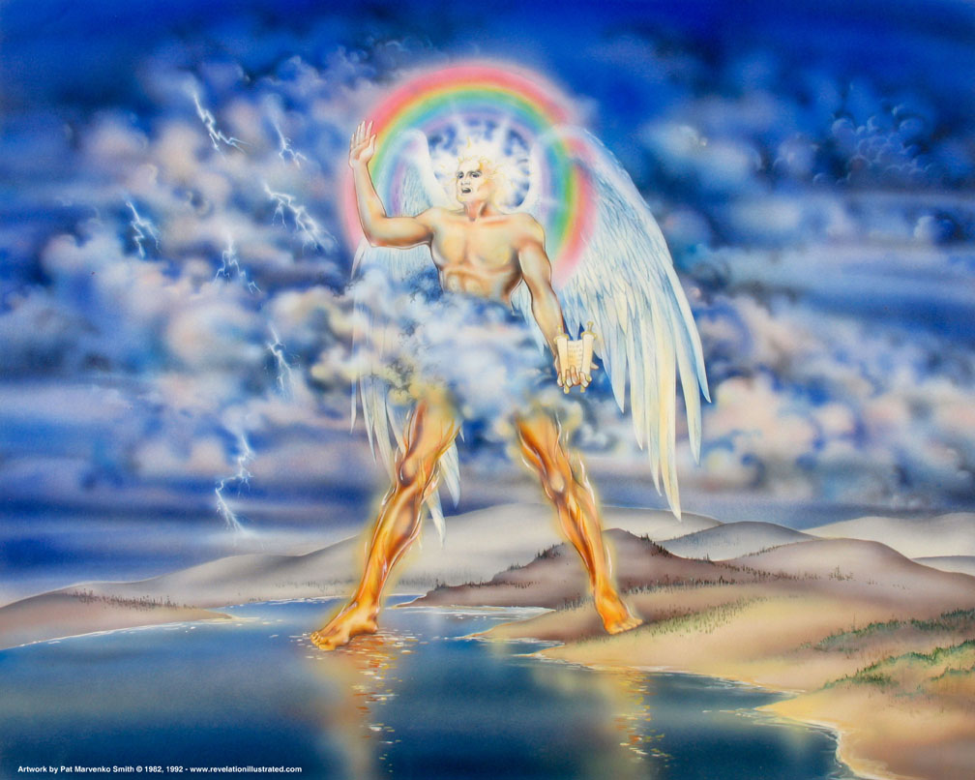
Book of Revelation: Chapter 10
The Little Book

Slide 6

Revelation 10:1
Revelation 10
“And I saw another strong angel coming down out of heaven, arrayed with a cloud; and the rainbow was upon his head, and his face was as the sun, and his feet as pillars of fire”

Slide 7
Revelation 10
Revelation 10:2
“and he had in his hand a little book open: and he set his right foot upon the sea, and his left upon the earth”

Slide 8
Revelation 10
Revelation 10:3
“and he cried with a great voice, as a lion roareth: and when he cried, the seven thunders uttered their voices.”

Slide 9
Another Angel
Revelation 10
Picture #1 – “the angel and the seven thunders”
A description of the angel:
“Strong – mighty angel” (5:2; 18:21)
“Coming down from heaven”
Suggests divine authority
Does this mean that John was on earth looking up into heaven?

Slide 10
Another Angel
Revelation 10
Picture #1 – “the angel and the seven thunders”
A description of the angel:
“Clothed with a cloud”
“Rainbow upon his head” (4:3; Ezek. 1:28)
“Face like the sun”
“Feet like pillars of fire”
From God’s presence

Slide 11
Another Angel
Revelation 10
Picture #1 – “the angel and the seven thunders”
A description of the angel:
“Placed his right foot on the sea and his left foot on the land”
Mastery over all the earth; a universal message

Slide 12
Another Angel
Revelation 10
Picture #1 – “the angel and the seven thunders”
A description of the angel:
“Has a little book open in his hand” cf. 5:1. This book is “open” which means God wants these things revealed and not concealed as God instructed Daniel to do about his “visions” (Daniel 12:4, 9).
“Cries with a loud voice – as a lion roars”
“As he cried, seven thunders uttered their voices”
Not the same book that was sealed – a different book
A message for the whole earth
Roaring and thunders – commanded ATTENTION!

Slide 13
Revelation 10
Revelation 10:4
“And when the seven thunders uttered (their voices), I was about to write: and I heard a voice from heaven saying, Seal up the things which the seven thunders uttered, and write them not.”

Slide 14
Divine Instructions
Revelation 10
We do not know what John saw when the seven thunders spoke – he was commanded not to record them.
He was told to “seal up the things the seven thunders uttered.”
The voices of the thunders evidently belonged to that region of “visions and revelations of the Lord” to which Paul referred as “unspeakable words not lawful for a man to utter.” (2 Corinthians 12:1-4)
Other forces are at God’s disposal for judgments which are not recorded.
Shows his great power.
All that is needed is the assurance that God hears the pleas of the righteous and turns his face against the wicked (1 Peter 3:10-16).
Deuteronomy 29:29

Slide 15
Revelation 10
Revelation 10:5
“And the angel that I saw standing upon the sea and upon the earth lifted up his right hand to heaven”

Slide 16
Revelation 10
Revelation 10:6
“and sware by him that liveth for ever and ever, who created the heaven and the things that are therein, and the earth and the things that are therein, and the sea and the things that are therein, that there shall be delay no longer”

Slide 17
The Angel’s Oath
Revelation 10
The angel lifted his right hand and made a solemn oath.
By the eternal nature of God and His omnipotence – there would be no more delay!
Not the end of the world – but the outpouring of God’s wrath (6:9-11)
The Lord already issued warnings calling for repentance.
But they refused to repent. (9:20-21)

Slide 18
The Angel’s Oath
Revelation 10
Why should this come as a mystery?
Surely God has always intended for the church to survive!
Satan’s forces (Rome) would not be permitted to thwart God’s plans!
Never forget who is in control of man’s destiny.
Choices always have consequences!

Slide 19
Revelation 10
Revelation 10:7
“but in the days of the voice of the seventh angel, when he is about to sound, then is finished the mystery of God, according to the good tidings which he declared to his servants the prophets.”

Slide 20
Revelation 10
Revelation 10:7
God’s plan of redemption is no longer a mystery because it has been revealed (Romans 15:25-26; Ephesians 3:3-7).
Daniel prophesied that His kingdom would be established in the days of the fourth kingdom – the Roman Empire (Daniel 2:40, 44-45).
This was fulfilled when Christ arose from the grave and ascended to the right hand of God (Mark 1:14-15; 9:1; Daniel 7:13-14; Ephesians 1:20-23; Acts 2:30, 33-36; Galatians 4:4).
God’s kingdom would be unlike earthly nations which inevitably rise and fall. God’s kingdom is spiritual, and it shall stand forever (John 18:36; Daniel 2:44).

Slide 21
Revelation 10
Revelation 10:7
The prophets foretold of the “destruction of Jerusalem” by Romans!
This is found in Daniel 9:24-27 – abomination that maketh desolate! (cf. Matthew 24:15; Luke 21:20-24)
The “one that maketh desolate” shall also be punished afterward (verse 27).
The prophets also foretold in “visions and prophecies” that Rome would also be destroyed.
The “mystery” would be completed when the “end” came.

Slide 22
Revelation 10
Revelation 10:7
Another mystery to be revealed: Daniel 7
Daniel also foretold how God’s kingdom would be opposed by this fourth empire (Daniel 7:15-28).
The Roman Empire, led by wicked rulers both in Rome and the chief provinces, would make war with the saints, but it would not prevail.
Instead, “But the saints of the Most High shall receive the kingdom, and possess the kingdom for ever, even for ever and ever.” (Daniel 7:18; cf. Daniel 7:22-27).
Revelation discloses the fulfillment of this prophecy and explains how this mystery of God should be finished.

